Slide 1
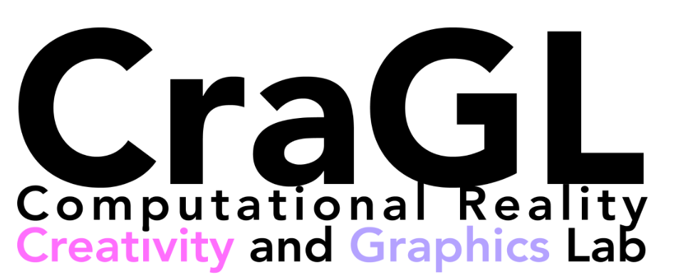
ShapeSonic: Sonifying Fingertip Interactions for Non-Visual Virtual Shape Perception
Jialin Huang George Mason University
Rana Hanocka University of Chicago
Alexa Siu Adobe Research
Yotam Gingold George Mason University
Notes:
Good afternoon, My name is Jialin Huang
and today I’m gonna share the work done by me and Prof. Rana Hanocka from University of Chicago, researcher Alexa siu from Adobe research and My advisor Professor Yotam Gingold.

Slide 2
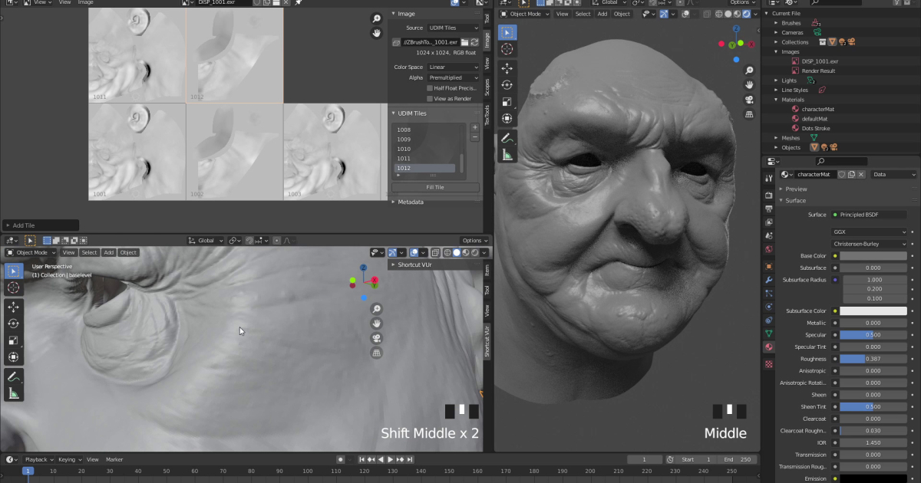
How can we create a non-visual interface for shape perception?
Notes:
Traditional computer graphics build the connection between real shapes with shapes shown on 2D screen even 3D in XR devices with visual feedback.
However, how could blind people see virtual 2D and 3D shapes?
we can design interfaces rely on other feedback like tactile, auditory, rather than visual.

Slide 3
3D design tools are inaccessible to BVI users
Digital design software relies on visual perception
How can we create a non-visual interface for shape perception?
Notes:
Graphical content is invisible, Mouse input is hard to track 3D shape projected on a 2D screen is not intuitive
Sound
Touch
Visual interactions are inaccessible to BVI users.
Image source copyright:
https://parametric-architecture.com/8-free-browser-based-3d-modeling-software-for-beginners/
https://engre.co/blogs/articles/top-5-3d-modeling-tools/

Slide 4
Tactile Approaches
Panotopoulou et al. 2020
Siu et al. 2019
Notes:
There are some works done for this purpose and they designed the program to provide tactile feedback like it in the real world.
For example, the work of Panotopoulou fabricated the illustration by popup lines to mimic the curvature and geometry of 3D shapes.
The second work shows the device created by Siu which can roughly simulate 3D shapes as heightmaps of pins.
However, compared to Auditory, interfaces rely on haptic feedback need specialized devices or fabrication process.
These interfaces are less available and less suitable for real-time feedback and interaction .

Slide 5
ShapeSonic is a sonification-based approach for perceiving shapes
Notes:
So we designed an interface, called ShapeSonic, which uses only auditory feedback.
(click video)specifically, ShapeSonic is a sonification-based approach for shape perceiving.

Slide 6
Sonification is mapping information to sound
Sonification: The Music of Data [Jesse Strickland]
Notes:
What is sonification?
Sonification is the use of non-speech audio to convey information or perceptualize data.
There is an example about perceptualizing line chart. (click)By this, you can perceive the data by the tone and timbre of two sounds.

Slide 7
How should hands map to sound?
Volume
Pitch
Timbre
Spatialization
Tempo
...
Notes:
In our design, we use the handtracking of the oculus to track the movement of fingertips.
We want to map hands to sounds, but how?
In the design space of hands, we tried interaction with only fingertips(click), or whole hands(click). We also tried use the curvature of hands(click).
(click)we chose to use only the position of ten fingertips, which is clearer to users during our trials.
In the design space of sounds features, we chose (click) volume, pitch, timber, and spatialization.
Image Copyright: https://docs.ultraleap.com/xr-guidelines/Getting%20started/virtual-hands.html

Slide 8
Sonification regions divide space around the shape into zones
Corner
Outside
Inside
Edge
Notes:
In detail, the sonification regions in our design divide space around the shape into zones.
Here, there are (click)outside, (click)inside and (click)space around sharp edges and corners.
In each zone, there are different sonification design.

Slide 9
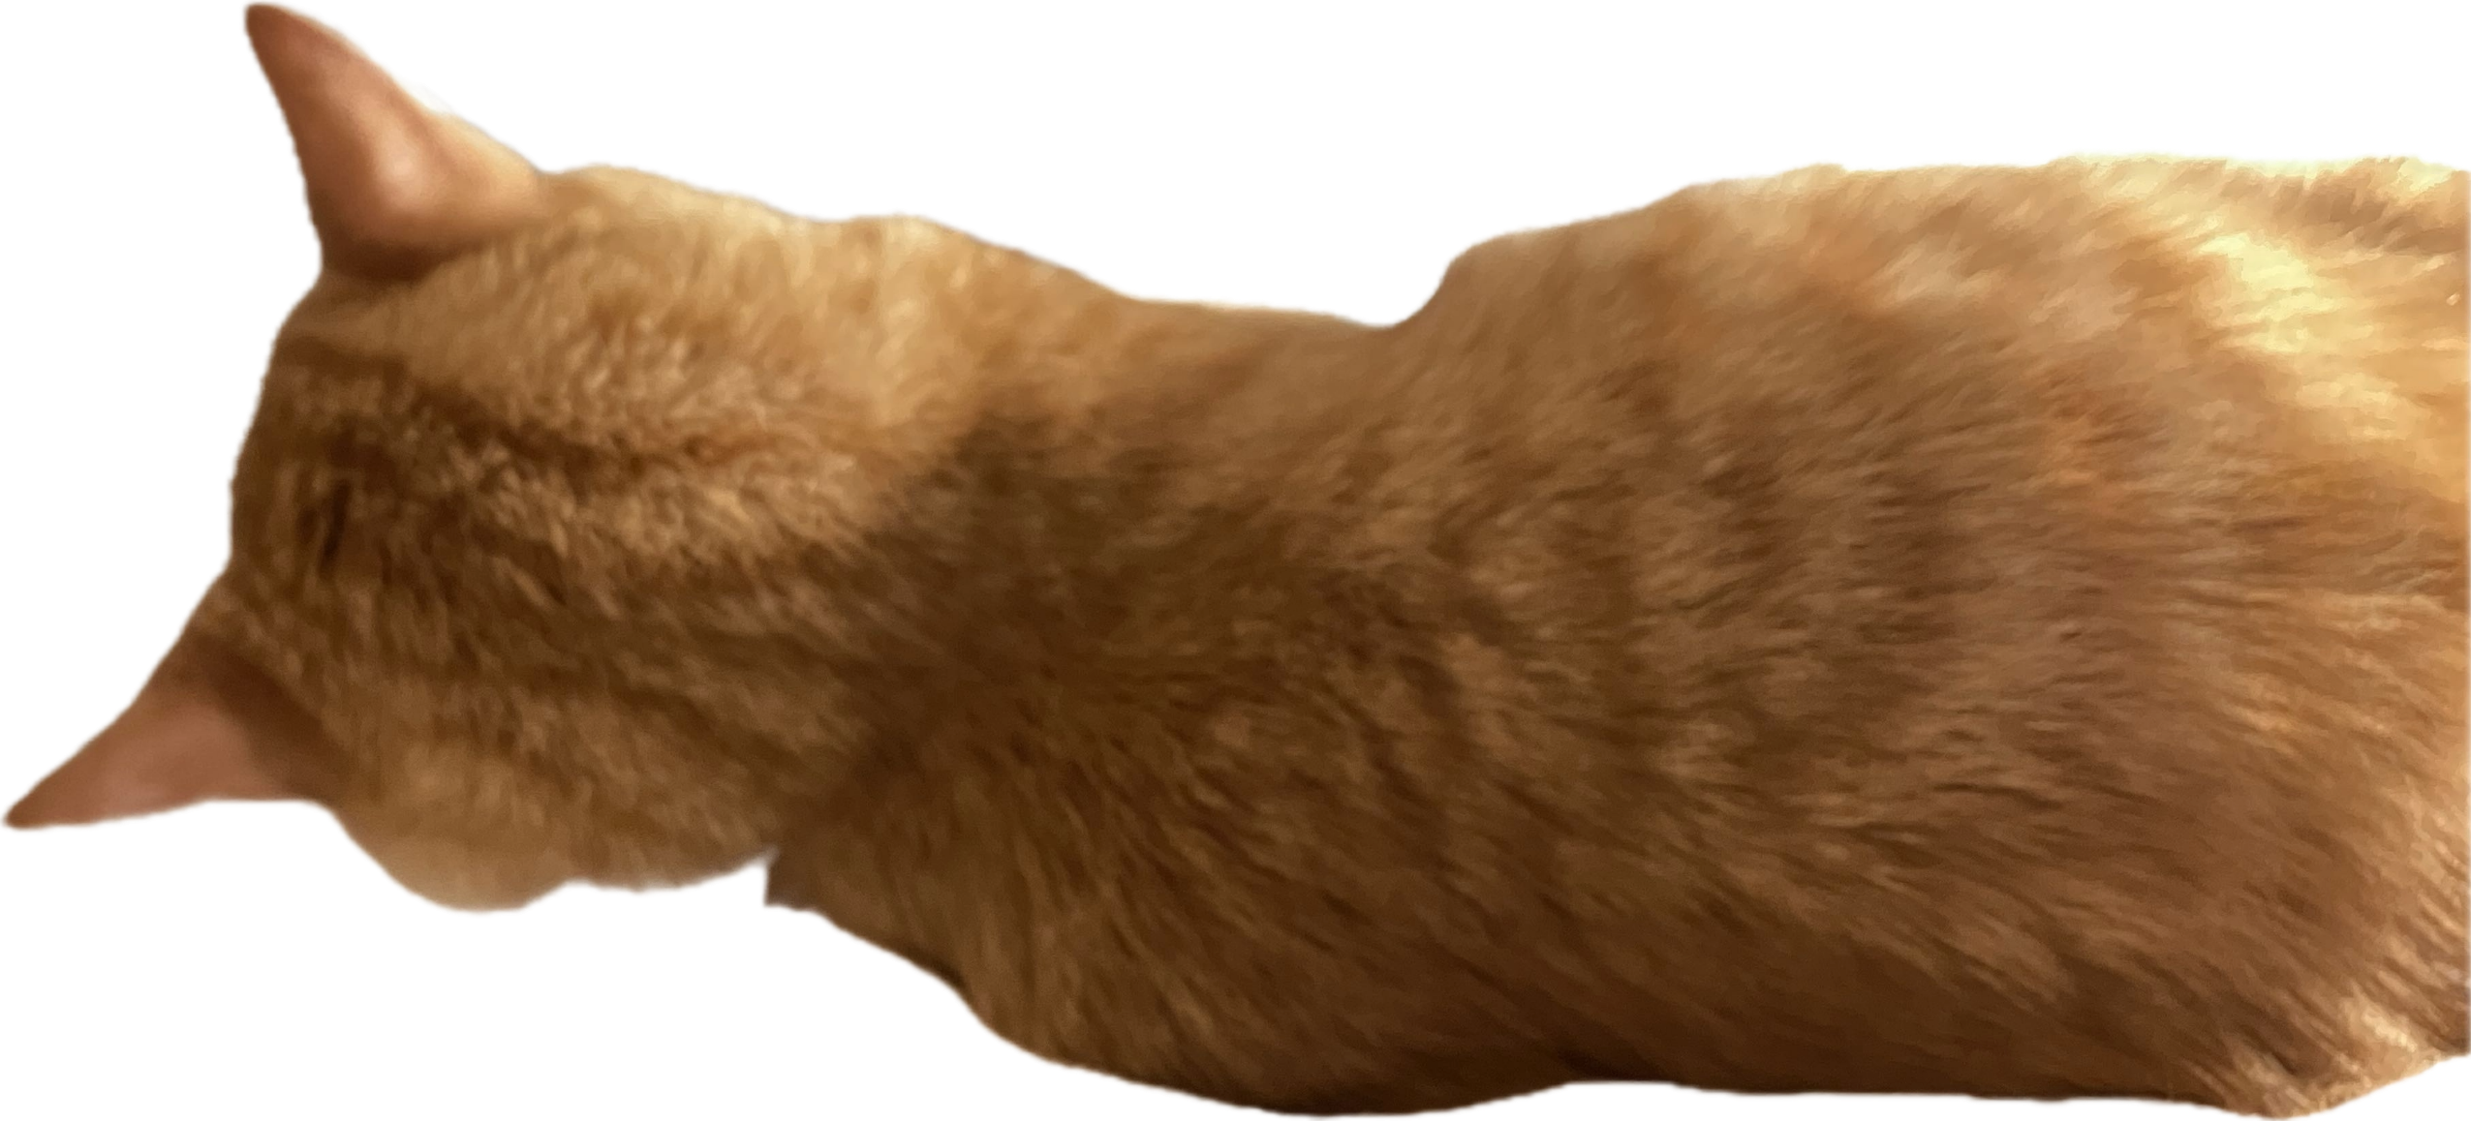
Spatialization
Notes:
Also, Sounds triggered by left and right hand would map to left and right ear to indicate the direction.
Compared to stereophonic sound, only left and right audio ensures an unambiguous mapping from hands.
Also, To provide pleasant and distinguish sounds, We hired a professional sound designer to design our sounds.
Image Copyright: https://docs.ultraleap.com/xr-guidelines/Getting%20started/virtual-hands.html

Slide 10
Corner
Corner
Edge
Edge
Notes:
In detail, I will show the designs of four sounds in the following page.
(click) The first one is the guidance sound

Slide 11
Guidance sounds play outside the shape
Notes:
The guidance sound will only play outside of the shape.
Here, Distance is loudness. The closer the fingertips to the shape, the louder the sound.
(click) This sound can guide the users toward the surface of the shape from the outside.

Slide 12
Corner
Corner
Edge
Edge
Notes:
（click）The second sound is contact sound,

Slide 13
Contact sounds play on the surface and inside the shape
Notes:
It plays when fingertips get on the surface or into the shape.
And fingertip contact maps to a pentatonic scale.
This gives the user the ability to detect whenever a fingertip comes in and out of contact with the surface of the shape.

Slide 14
Corner
Corner
Edge
Edge
Notes:
（click) The third and fourth sounds are edge sound and corner sound.

Slide 15
Edges and corners trigger earcons
Edge Sound (right)
Corner Sound (left)
Notes:
they play around the sharp edges and corners respectively
We use earcons for sharp edges and corners.
Touching an edge plays a sound resembling a plucked guitar string. (click)
Touching a corner plays a bell-like sound.(click)

Slide 16
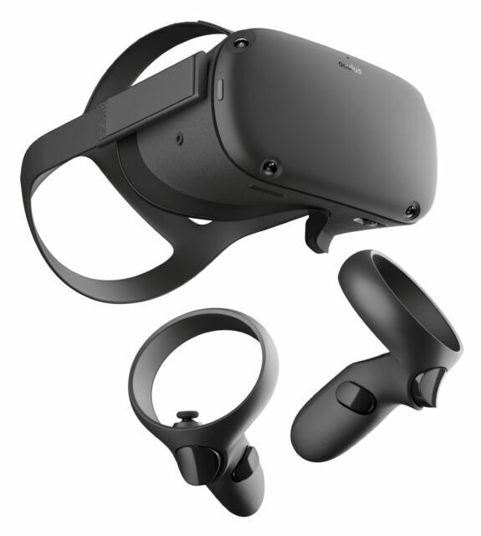
Implementation
Meta Oculus Quest
Signed distance field
Notes:
Implementing ShapeSonic requires reliable hand tracking, stereo headphones, and fairly light computing needs
We chose the widely available and affordable Oculus Quest VR headset
We pre-computed the signed distance field of objects to less the computing on headset.

Slide 17
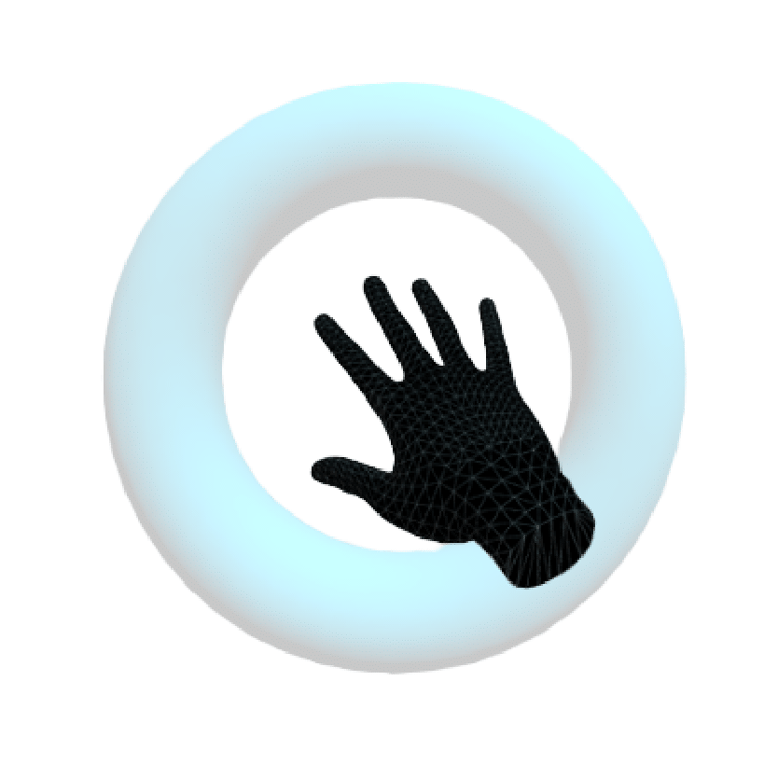
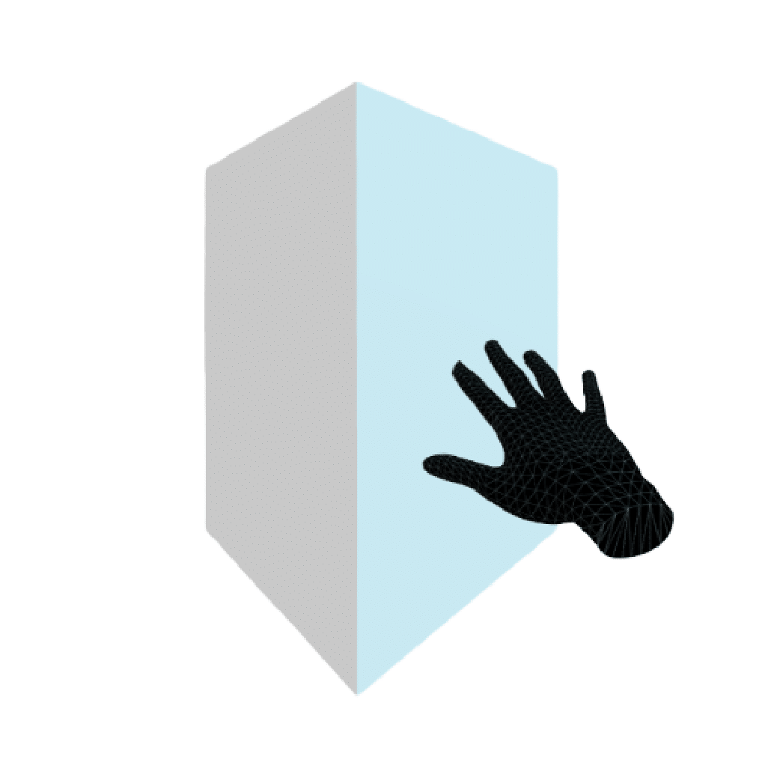
Experiment Setting
15 sighted and 6 BVI testers
Two rounds:
Pilot Study
Formal Study
Two shape perception tasks
Shape Recognition
Landmark localization
Shape elements used in tutorial
Notes:
(click)After our designing and implementing,
We evaluated ShapeSonic with 15 sighted and 6 BVI users
(click)We invited 6 sighted people for pilot study
after improving some sonification designs and the setting of study,
we invited 9 sighted and 6 bvi users to join the study.
The study protocol began with a 10-minute tutorial and training period,
we guided participants to hear all forms of sonifications and taught them basic strategies via exploring the torus and prism.
(click) The user study has two tasks: shape recognition and landmark localization

Slide 18
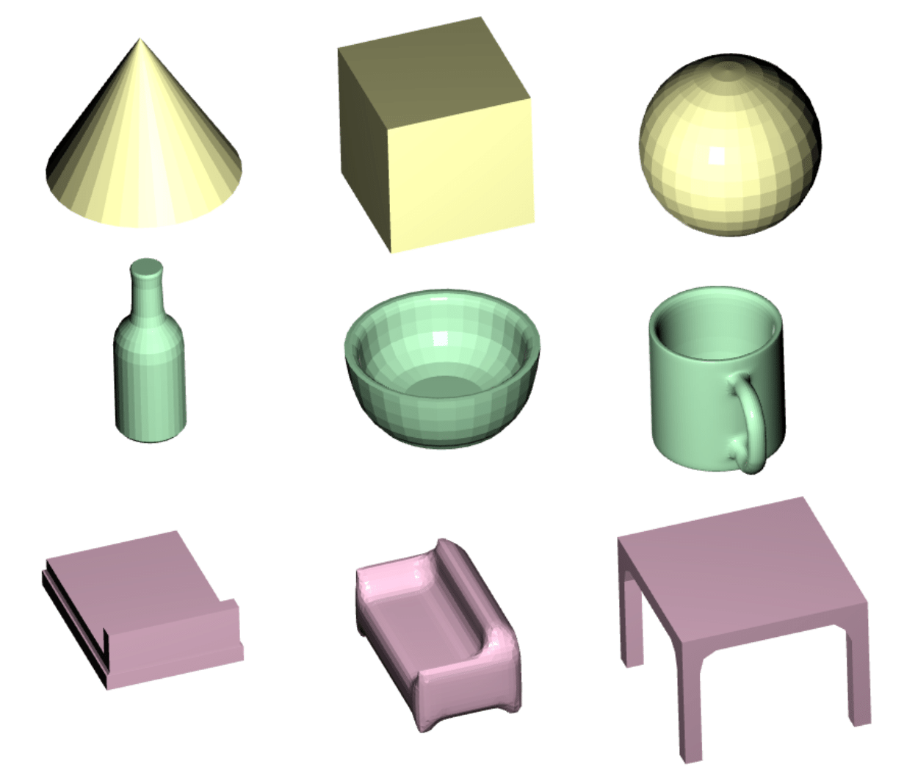
Shape Recognition Task
Identify one of three shapes
37/45 ShapeSonic vs. 15/45 chance
Sighted and BVI users had similar performance (81% vs. 83%)
Notes:
In shape recognition task of formal study, there are totally three rounds, in each round, they would explore with one of three shapes in one row randomly.
Before each round, participants were given a brief description of three shapes, and after exploring, they were asked to identify which shape it was.
(click)
In the overall 45 trials in the formal study, they successfully identified 37 times, which is much higher than 15 times as random guessing
(click)Also, from the result, we can see sighted and BVI users got similar performance, which means ShapeSonic is effective in allowing both sighted and
BVI users to identify shapes.

Slide 19
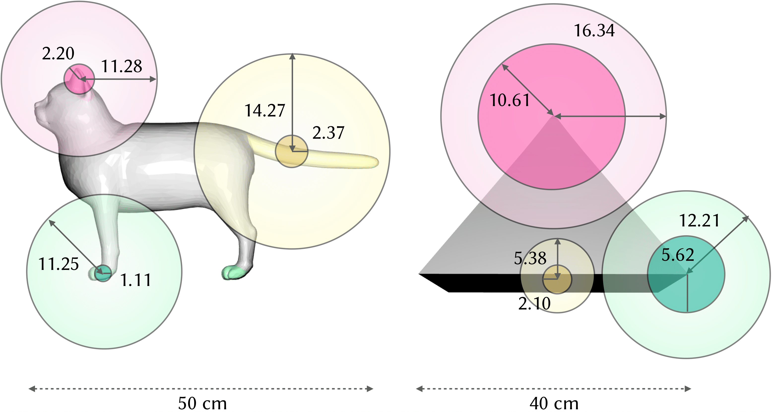
Landmark Localization Task
Notes:
In landmark localization task, we provided a verbal description about the shapes, and we asked participants to touch each landmark without sonification, which provided a baseline for comparison.
After that, they were asked to relocated landmarks after five minutes interaction with sonification.
The figure shows the improvement in landmark positioning error when using sonification.
Sonification improved landmark positioning accuracy for all features.
We found no significant overall differences between sighted and BVI participants.
Two participants who both were bvi from birth showed exceptional improvement when using our sonification.

Slide 20
Observations
Perceived as halfway between verbal description and feeling a physical shape.
Haven’t reached the skill ceiling.
Hand tracking latency is an impediment.
Notes:
After the study, we asked participants to finish a questionnaire about their feelings.
(click)From the likert plot, Participants perceived the experience halfway between verbal description and feeling a physical shape.*/We believe both verbal and sonification information are necessary for successful perception
(click)From the feedback of participants, some of them were struggled with remembering all the sounds,
While some of them requested more sound feedback to provide additional information.
In our observation, all could learn the meaning of all sounds when they did the second task, which means we haven’t reached the end of training phase.
(click)Also, The hand tracking latency forces users to move slower than they otherwise might.
Extremely low latency interactions may provide a sensation akin to “ear haptics,” where the tactile sensation is transferred.

Slide 21
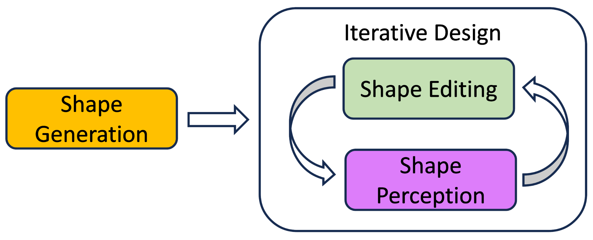
Future Work
Physical attributes
Complex objects and scenarios
Non-visual 3D shape design framework
Notes:
(click)In the future, we’d like to explore sonification of additional physical attributes, like material, texture, softness, color, etc.
(click)Also, we want to apply the sonification on more complex objects and scenarios.
(click)lastly, we want to integrate with shape editing/generation module to form a closed-loop non-visual 3D shape design framework

Slide 22
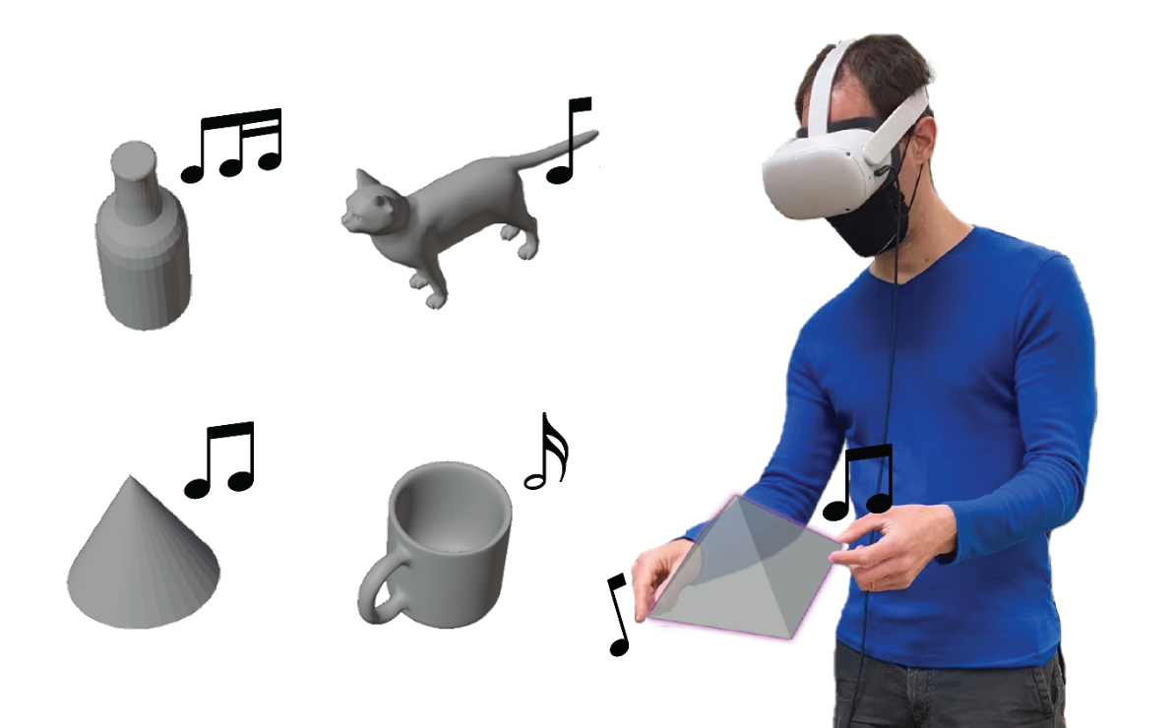
ShapeSonic: Sonifying Fingertip Interactions for Non-Visual Virtual Shape Perception
https://cragl.cs.gmu.edu/shapesonic/
Notes:
Thank you for listening and come to my q&a session to try the sonification if you are interested!

